Slide 1
Week 6 – Wednesday: Building a Web Page (and a tiny bit of git)
R. Jordan Crouser
Assistant Professor of Computer Science
Smith College
SCS Noonan Scholars – Summer 2018

Slide 2
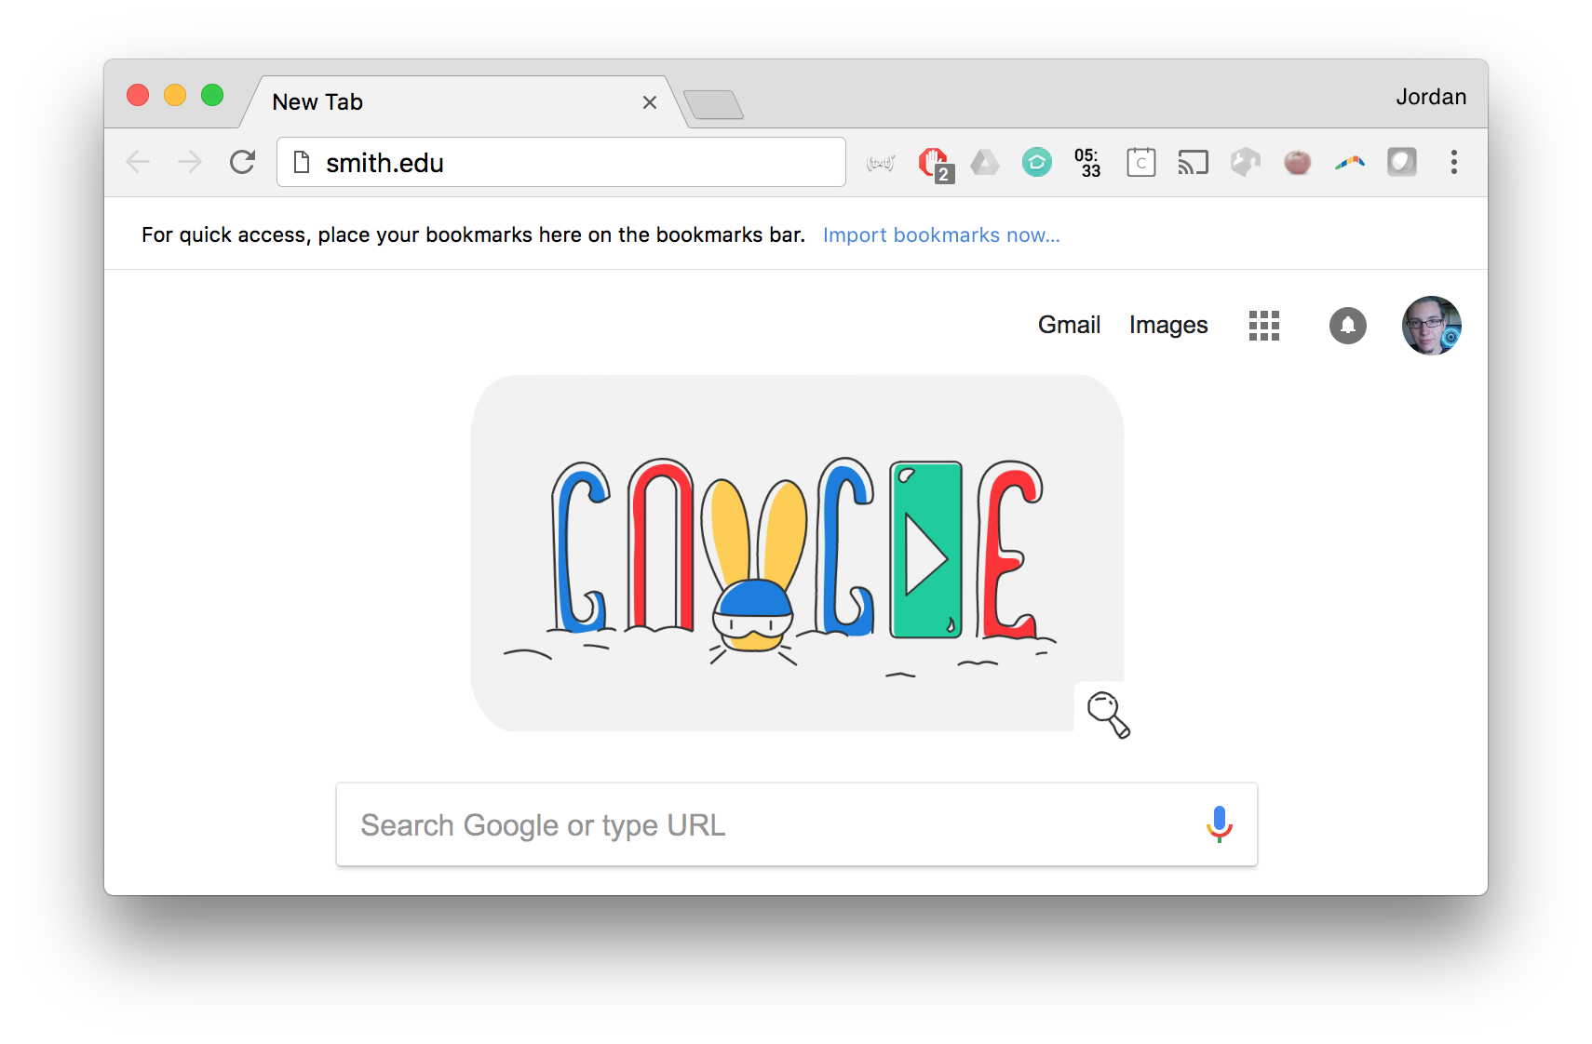

Quick digression
What actually happens when you type a URL
into your web browser and hit ‘ENTER’?

Slide 3
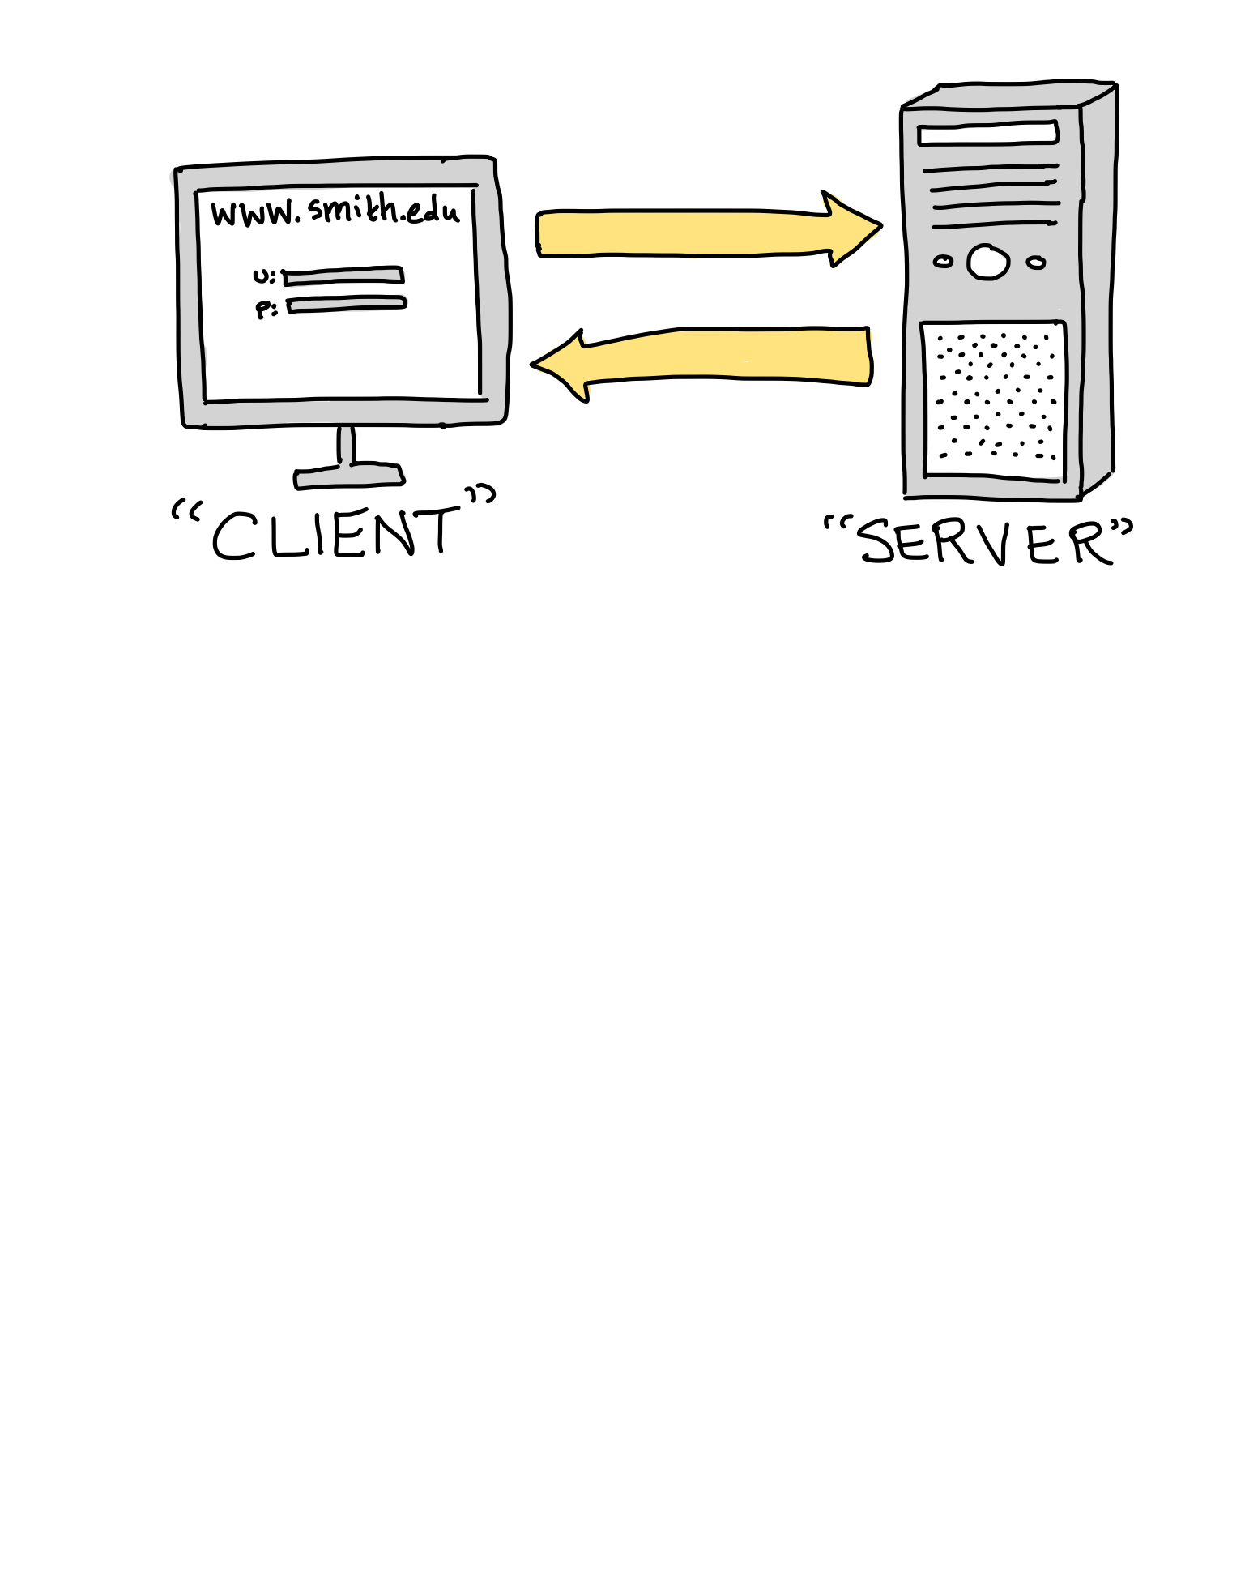
Client and server

Slide 4
Client and server

Slide 5
The web programming trifecta
Image courtesy R. Kuliga, University NSW

Slide 6
HyperText Markup Language (HTML)
Image courtesy R. Kuliga, University NSW

Slide 7
HyperText Markup Language (HTML)
HTML is a text formatting language (as opposed to a programming language)
Composed of plain text along with “tags” (instructions contained in <angle brackets>) that specify formatting
No special development environment – can write .html files in any text editor (though tools exist to make web programming easier)
The resulting “formatted text” is most commonly displayed within a web browser

Slide 8
Common tags
most html tags come in pairs: <open> and </close>
Some useful ones:
<p>…</p>: a paragraph
<h1>…</h1> (or h2, h3, …): a header
<strong>…</strong>: make inner text bold
<a href = “…”>…</a>: make inner text into a clickable link
<ul>…</ul>: make an unordered (bulleted) list
<ol>…</ol>: make an ordered (numbered) list
<li>…</li>: make an item inside a list
<div>…</div>: make a division (group) of elements
<img src = “…” />: load an image (self-closing tag)

Slide 9
Our first web page

Slide 10
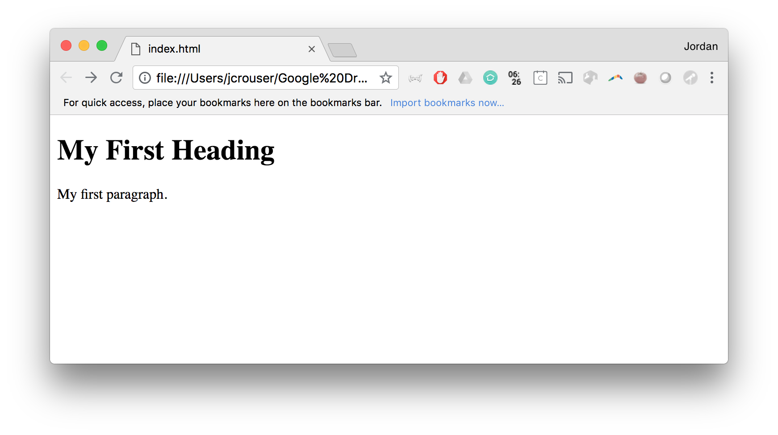
Something to notice…
this file is currently
living on your computer
(and other computers
have no way to access it)

Slide 11
Client and server

Slide 12
GitHub to the rescue!
GitHub is a platform for version control and collaborative software development
It also (conveniently) hosts web pages, which is what we’ll use it for today
To get started:
go to github.com and create a free account
create a new repository called ***.github.io where you replace *** with your username
create a new file called index.html, paste in the contents of your old index.html

Slide 13
This isn’t really how git is meant to work…
It’s kind of a pain to need to copy/paste files into the git interface every time your want to upload something
Instead, you can clone the repository to your computer so you can easily edit files there
Then when you’re ready, you can commit the changes back to the repository so others can see them
Note: today I’m going to show you the bare minimum about working with git… there is plenty more to learn about merging files, etc.

Slide 14
Our first web page

Slide 15
Cascading Style Sheets (CSS)
Image courtesy R. Kuliga, University NSW

Slide 16
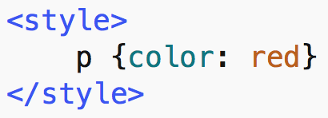
Cascading Style Sheets (CSS)
Used for changing the visual appearance of html elements
Can be defined on individual objects:
Can also be defined on all objects of a particular type:

Slide 17
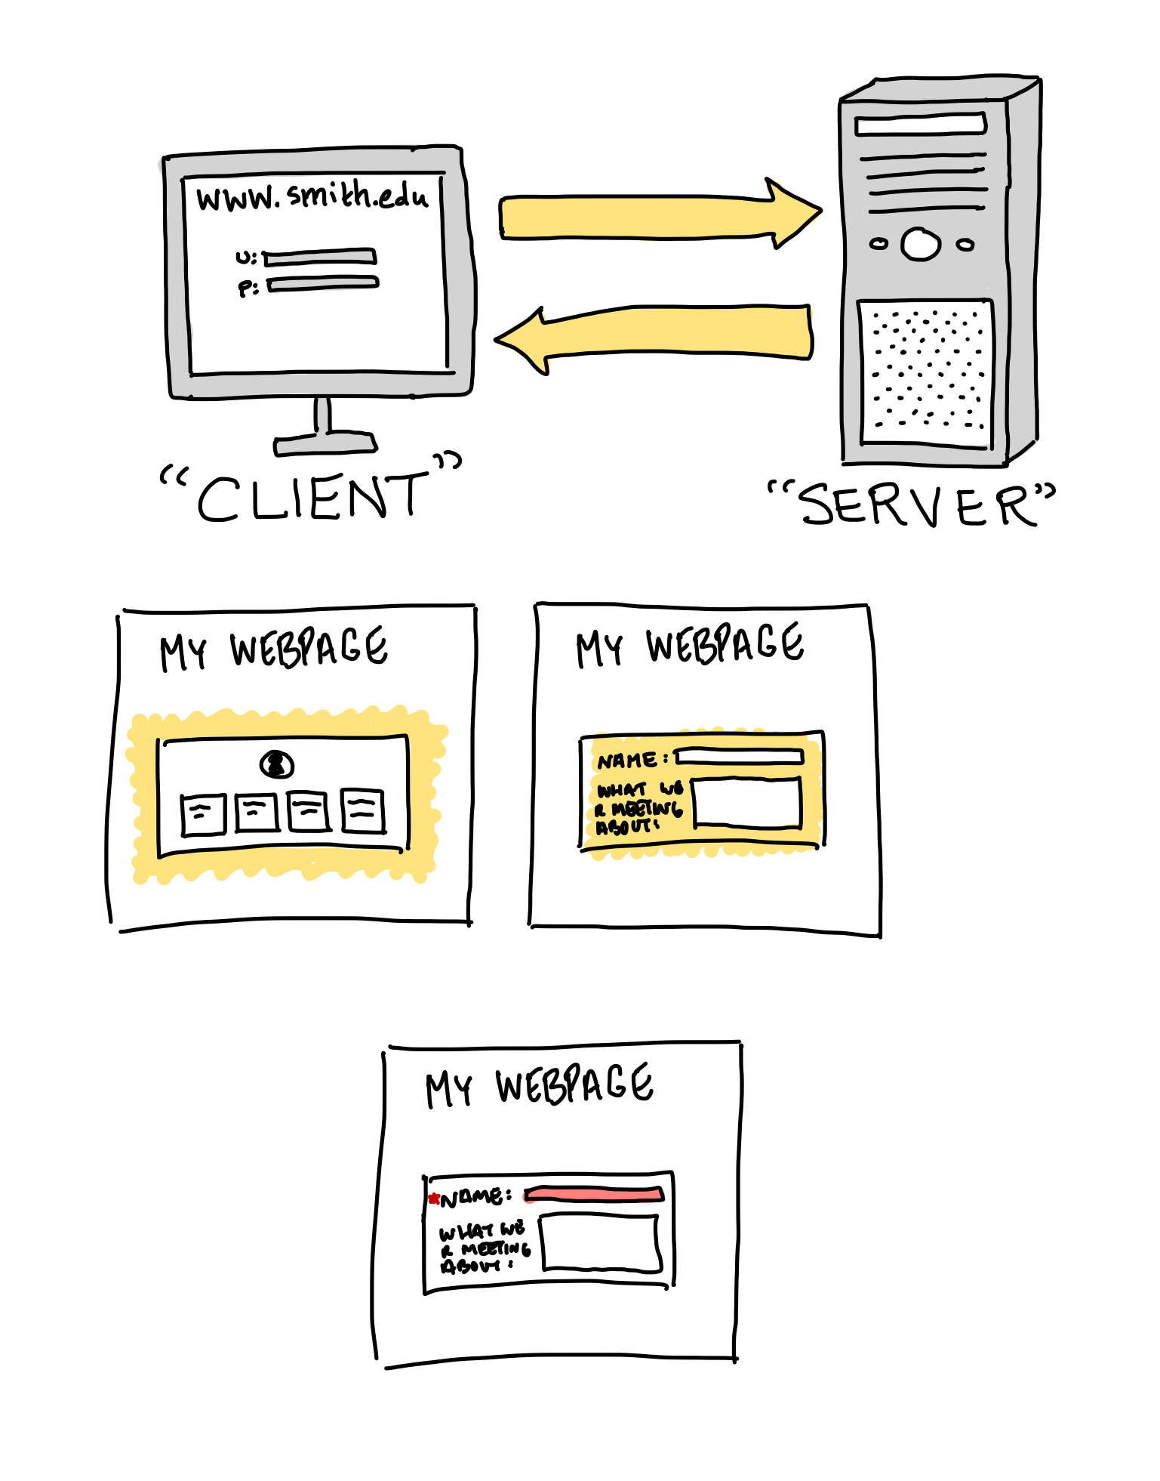
What can in-browser JS do?
Change how a page looks:
add new HTML
change existing content
modify styles

Slide 18
What else can in-browser JS do?
React to user actions (clicks, movements, key presses)
Send requests to remote servers
request data
download and upload files
Remember data on the client-side ("local storage")

Slide 19
What can’t in-browser JS do?
No direct access to hardware
No read/write to disk
No enabling peripherals without explicit consent
No talking to the OS

Slide 20
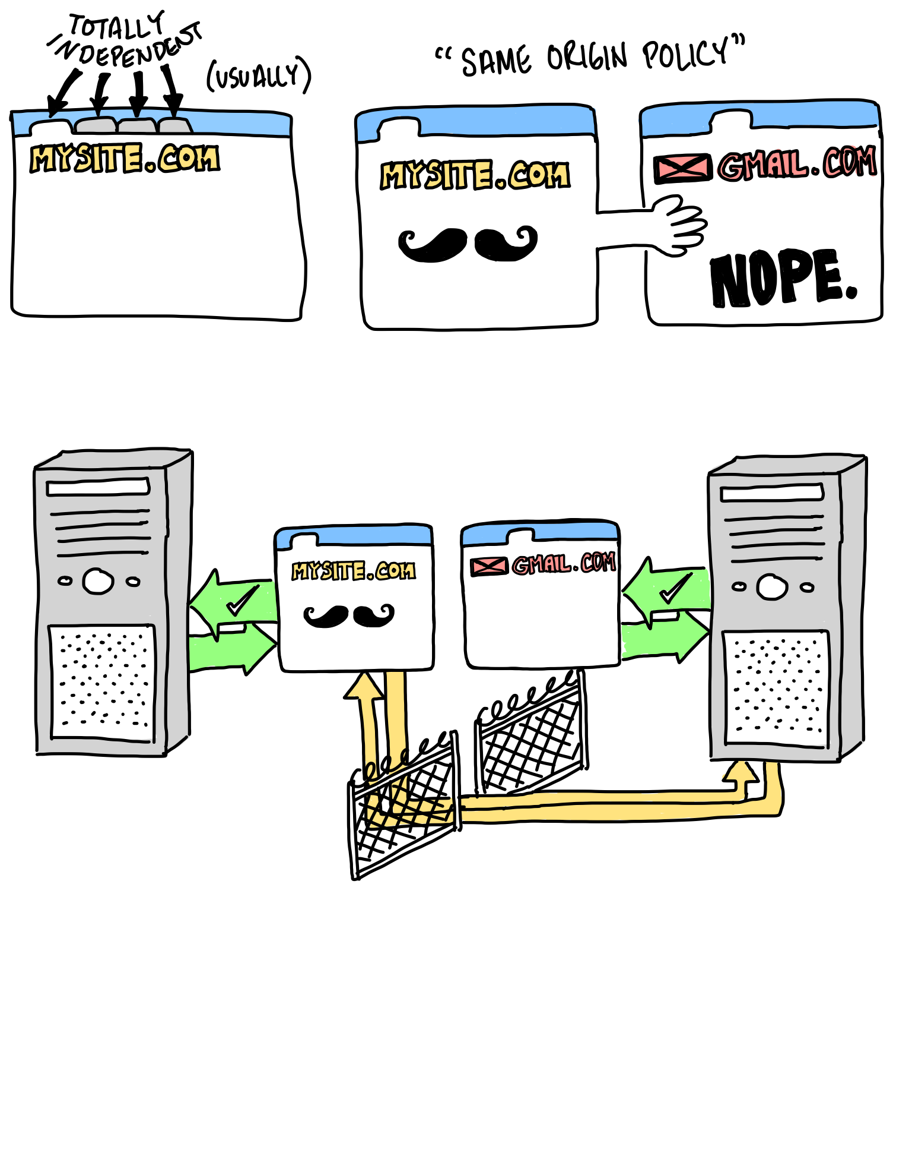
What else can’t in-browser JS do?
Communication is restricted even within the browser
Tabs and windows are independent
When they’re allowed to communicate, they have to be from the same origin (i.e. same website)

Slide 21
This week
Monday: pygame
Tuesday: Human-Computer Interaction (HCI)
Wednesday: Making a Web Page
Thursday: Ethical Questions in CS (with Yoo Jeen)
Friday: Wrapping Up and Final Project Demonstrations

